Slide 1

Smart City Project
Group 3
MAAZ HUSSAINI
RAVI TEJA TADIBOINA
OWEN WURSTER
RAHUL SATLA
DAX SHETHIA
KEVIN ZHENG

Slide 2

Introduction
Who is our Target Audience?
The target audience for this application is the general population of Albany.
What is our goal?
We wanted to give the people of Albany a Hub where they could have access to information about the area.
Notes:
Starting out, the first thing we did was to look at other smart city implementations.
What kind of features do they have? How did they build the application? How long did it take them to do it?
Looking at other implementation help us narrow out scope and focus. However, it was still too broad, so we decided to look at the target audience. Who should this application primarily serve?
Us! Or people coming to Albany for the first time.
Some core feature we wanted in the applications are Hotels, Bankings, and Transportation.

Slide 3

Analysis
User Requirements:
Users should have easy access to data regarding the Albany region, this ranges from job listings offered by NYS, transportation information, news and hotels.
Specifications and Interface needs:
We will produce a Java Desktop Application that allows the user to access a variety of data stored in an organized panel system, this system will require the user to have some type of internet connection and a computer.
Notes:
Given these initial question, we can pick what kind of programs we use.
We chose Java, because we all know it, and we want to demonstrate we know how to code in Java.
SQL is used communicate with out database.
We chose JavaFx to build out GUI.
AWS to hose out database.
We use Github as out version control system, and IntelliJ for the IDE
While not all of us are proficient in the technologies, we delegate and partition the task to best leverage out skills.
Lastely, we used Trello to manage out progress, and Teams to communicate.

Slide 4







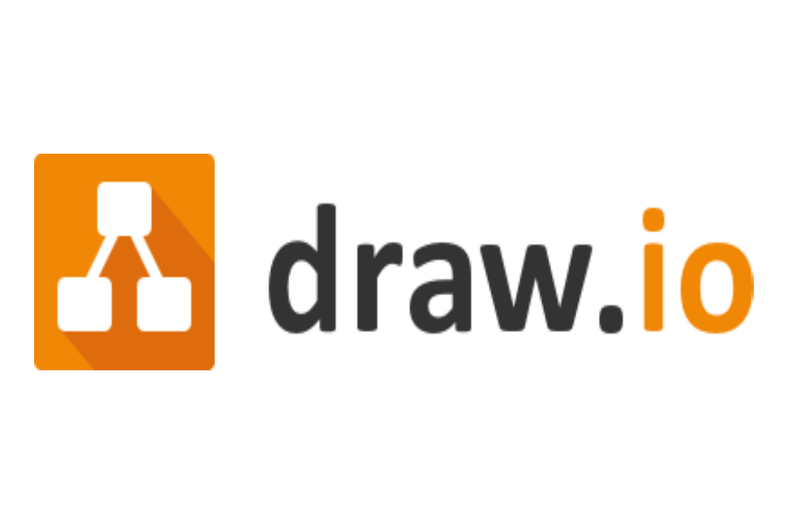
Resources
Langauges
Java
MySQL
JavaFX
API's
NewsData.io(200 daily requests)
GoogleMapsAPI(200 daily requests)
WeatherAPI(1M daily requests)
AWS RDS Database
Git/Github
Trello
Draw.io
Notes:
Given these initial question, we can pick what kind of programs we use.
We chose Java, because we all know it, and we want to demonstrate we know how to code in Java.
SQL is used communicate with out database.
We chose JavaFx to build out GUI.
AWS to hose out database.
We use Github as out version control system, and IntelliJ for the IDE
While not all of us are proficient in the technologies, we delegate and partition the task to best leverage out skills.
Lastely, we used Trello to manage out progress, and Teams to communicate.

Slide 5

What are the core features?
Job Listings
Night Life
Banking
Transportation
Hotels
Events
Area Map
News
Notes:
What will the program look like?
Well, we wanted something visual to look and click at.
We wanted to book hotels, so we need some kind of external database to keep track of that
We want some kind of transportation service, and maps provide API that enrich the experience that we want to incorporate

Slide 6
What does our product do?
Admin Functions:
Job Listings: Employers can post and manage job openings.
Hotels: Hotel owners can update their listings and availability.
Events: Event organizers can promote and manage their events.
Banking: Bank administrators can provide real-time updates.
Google Maps Integration: Utilizes Google Maps API to display users' general locations, making it easy to find banks, colleges, hotels, and more.
Weather API: Keep users informed about the local weather conditions for a seamless experience.
Functionalities:
Job Listings: Find and apply for local job opportunities.
Hotels: Discover and book accommodations for your stay.
Nightlife and Events: Explore the city's entertainment options.
Transportation: Access information on public transit and routes.
Banking: Manage your finances with easy access to nearby banks.
Notes:
What will the program look like?
Well, we wanted something visual to look and click at.
We wanted to book hotels, so we need some kind of external database to keep track of that
We want some kind of transportation service, and maps provide API that enrich the experience that we want to incorporate

Slide 7
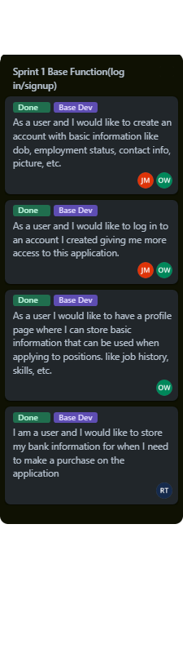
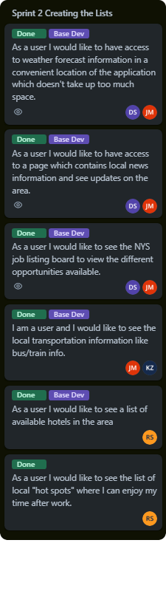
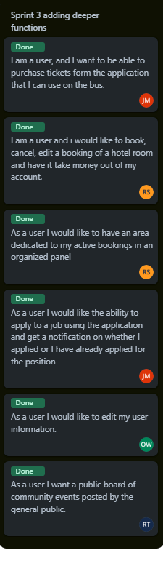
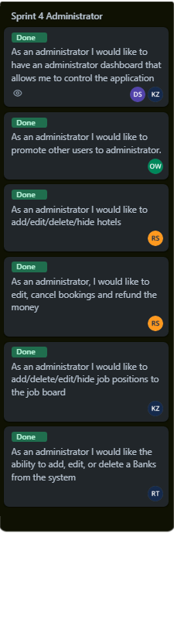
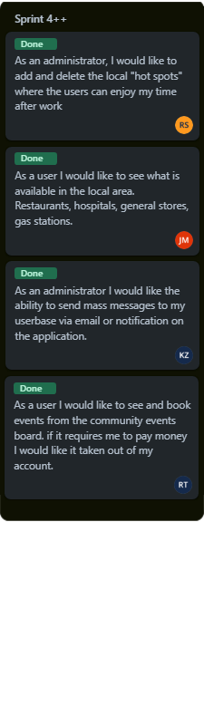
User Stories

Slide 8
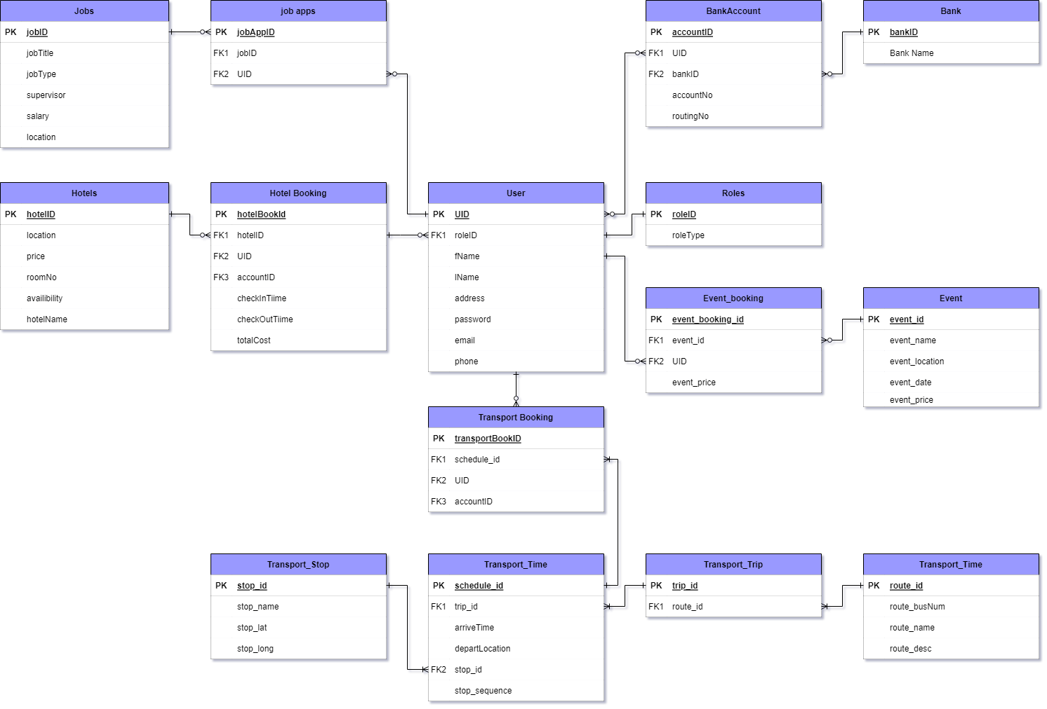
ERD ( Entity Relationship Diagram )

Slide 9
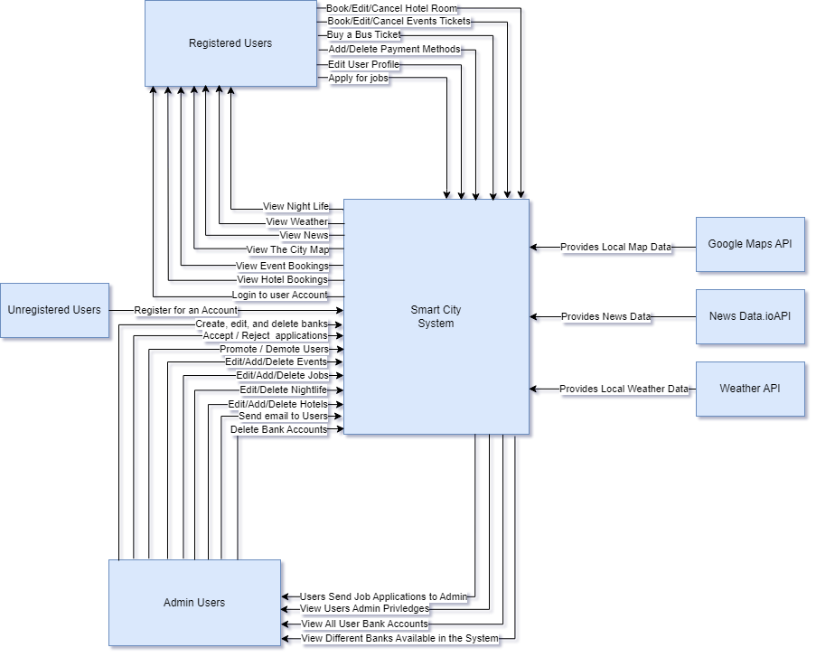
Context Diagram

Slide 11
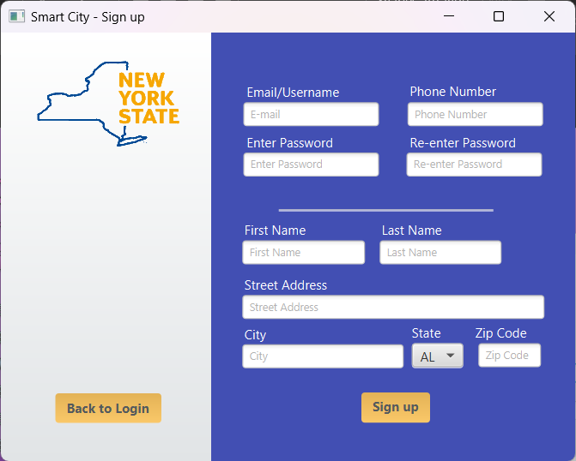
Sign-Up
Allows the User to sign up for the app by filling out the various fields with their information.
Once all fields are filled and the User clicks the "Sign up" button, a new account is created and saved to the database.
The User is then sent back to the login page to log into their new account.

Slide 12
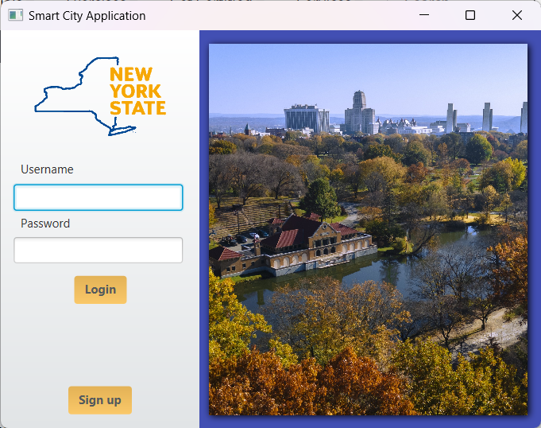
Login
Allows the User to login to the app using an account that they already have.
If the User doesn't have an account then they are given the option to create one.
When the User successfully logs in, they are sent to the landing page which is the main page of the app.

Slide 13
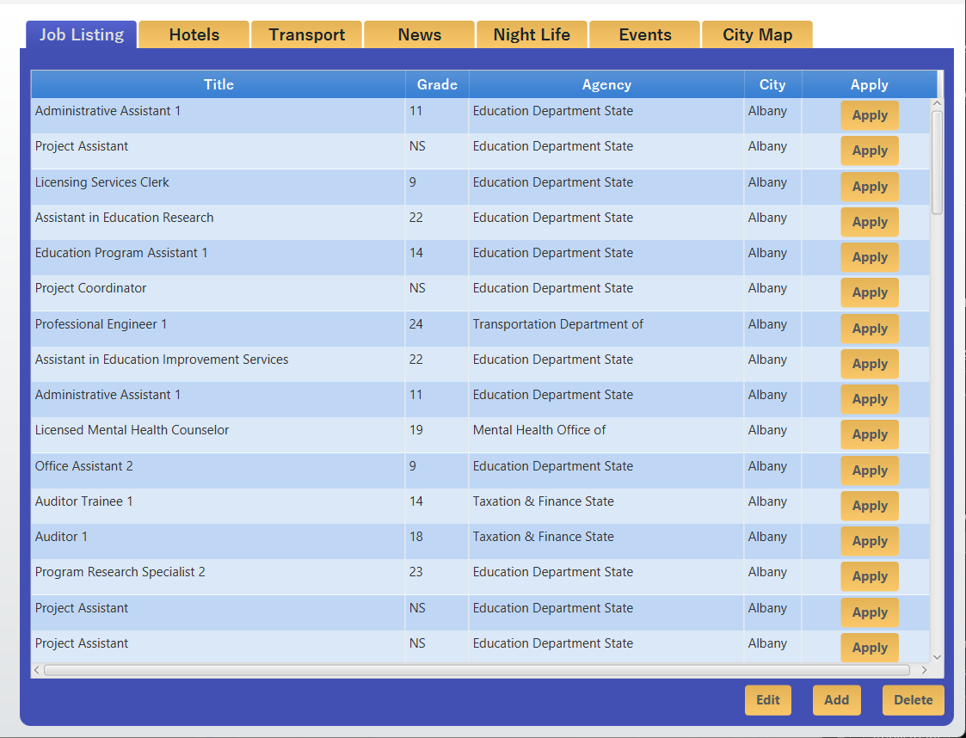
Job Listings
Since the application is intended for NYS to post jobs. the administrators are the only individuals who can add jobs.
Users can apply to the position by pressing the apply button and it will send the stored user information to the Admin panel.
Users can sort jobs by grades, agency, title, and city.

Slide 14
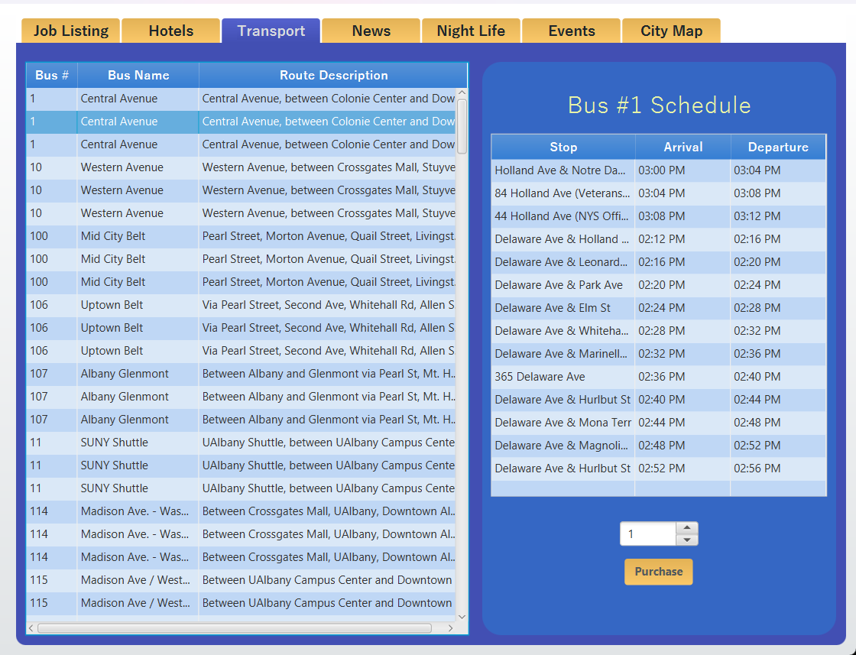
Transport
Data downloaded from CDTA online APIs
2650+ Bus routes throughout Albany area.
Each route has 12+ stops between start point and endpoint.
Initially we were loading all the data at the start of the application which would slow down the app launch time. To fix that issue we added multithreading for loading the stops data. We also revised the loading of the data of the stops so now it only loads data for each route when it is clicked by user instead of loading everyhting all at once.

Slide 15
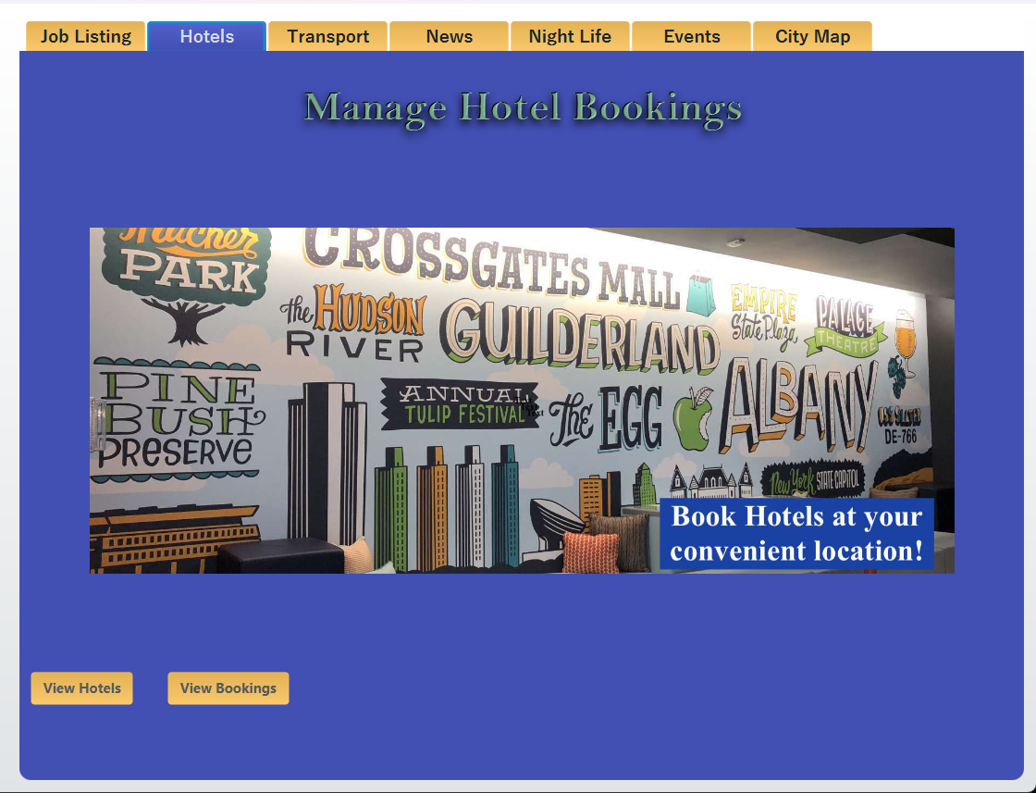
Hotels
User Experience:
Browse, book, and pay for hotels.
User-friendly interface with secure transactions.
View, cancel, edit, or extend bookings with refunds.
Admin Control:
Admin access to hotel management.
Add or delete hotels effortlessly.
Admin can book hotels for users.
Manage user bookings, including cancellations and extensions.
Admin Panel:
Access to a list of available hotels.
Streamlined booking process.
Search bookings by user email.
Perform actions on bookings.

Slide 16
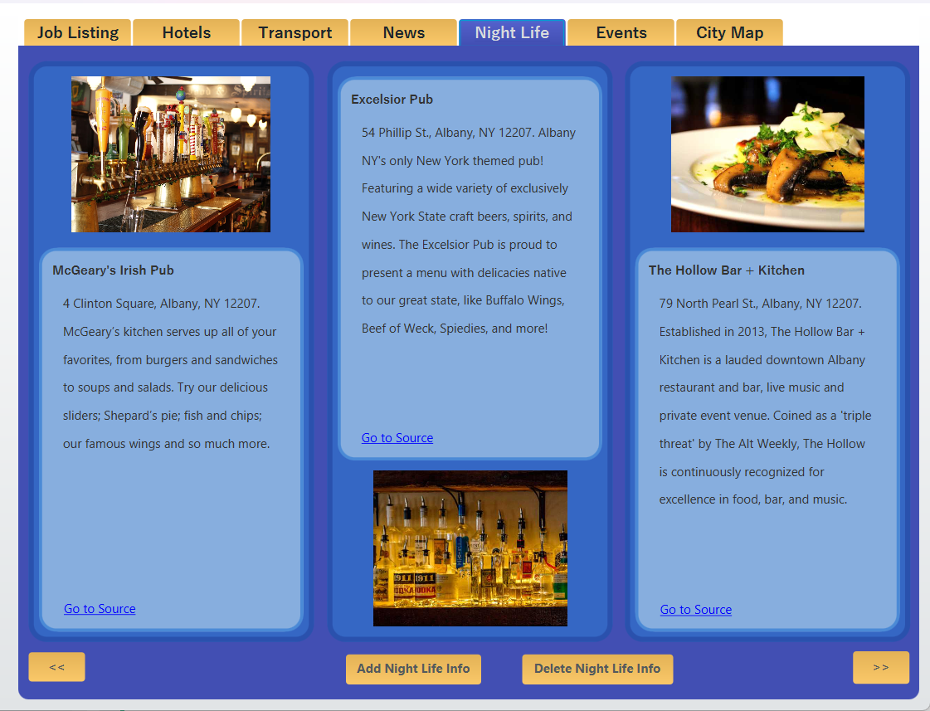
Night Life
User Experience:
Discover the city's vibrant nightlife.
Access information on hotspots like pubs, and more.
Website links and addresses provided for each hotspot
User access is limited to viewing.
Admin Control:
Admin can manage nightlife information.
Add new hotspots to the system.
Remove outdated or closed venues.

Slide 17
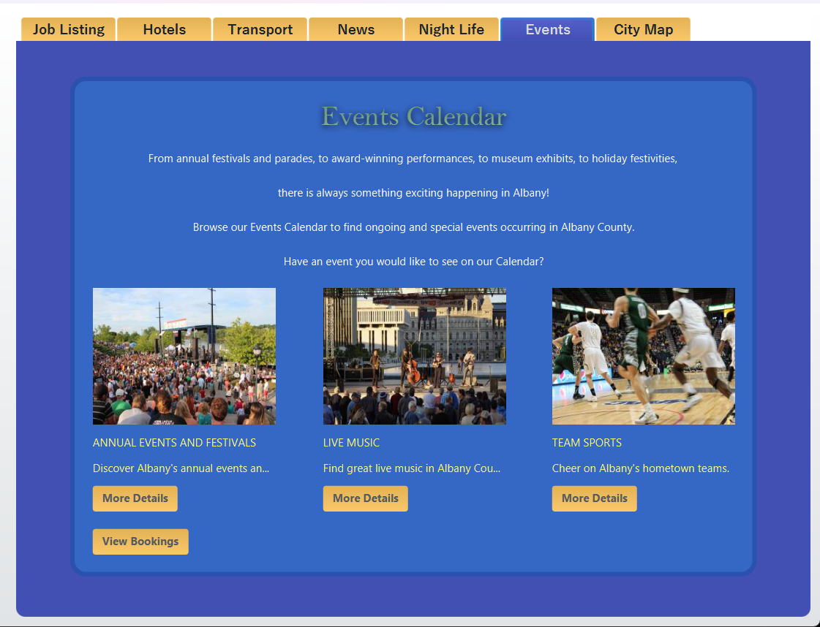
Events
User Functionality:
Users can book events from a list of available options, including annual events, live music, and sports events.
Users can view their booked events through the "View Bookings" feature, enhancing user experience and convenience.
Users have the flexibility to delete their event bookings if needed, providing control over their event plans.
Admin Functionality:
Administrators have the authority to create new events, expanding the event offerings available to users.
Admin can remove events from the list, maintaining event relevancy and ensuring a streamlined user experience.
Admin can view event bookings made by users, facilitating event management and support.
Admin can delete event bookings on behalf of users, offering assistance when necessary.

Slide 18
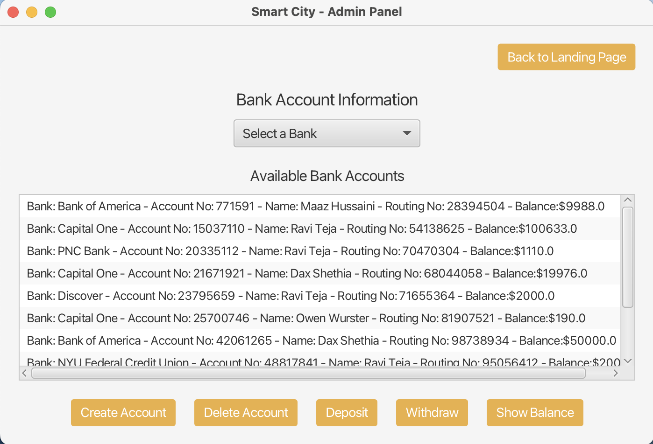
Bank Accounts
User Functionality:
Users can seamlessly create bank accounts by selecting from a list of available banks. This ensures a tailored banking experience.
Users are endowed with a comprehensive suite of operations, including depositing money, making withdrawals, and checking account balances, all in real-time.
For total control, users can delete their account anytime, ensuring they always have a grip over their financial footprint.
Admin Functionality:
Admins have a birds-eye view of all user bank accounts, ensuring they can provide prompt and efficient support.
The power to edit and update user data allows admins to maintain data integrity and cater to user requests.
The helm of the bank list is in the admin’s hand. They can introduce new banks, update existing ones, or even delist any. This dynamic control ensures that the bank list remains current and relevant.

Slide 19
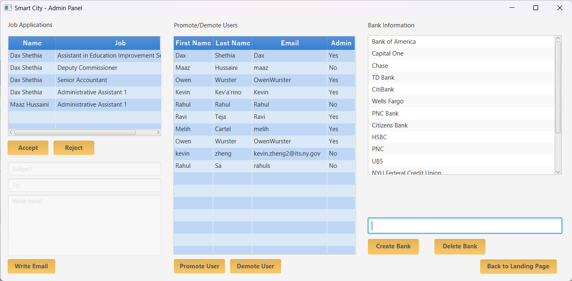
Admin Panel
-only admin can access this panel
-there are 3(4) functions
- It sends a SQL request and update locally once it is successful.
-the same applies for the list of users, which is all the user signed up in the system. You can use change a user's admin status.
Send email via Javamail(api/framework) and google smtp.
Simple Mail Transfer Protocol is a server that sends mail for you

Slide 20
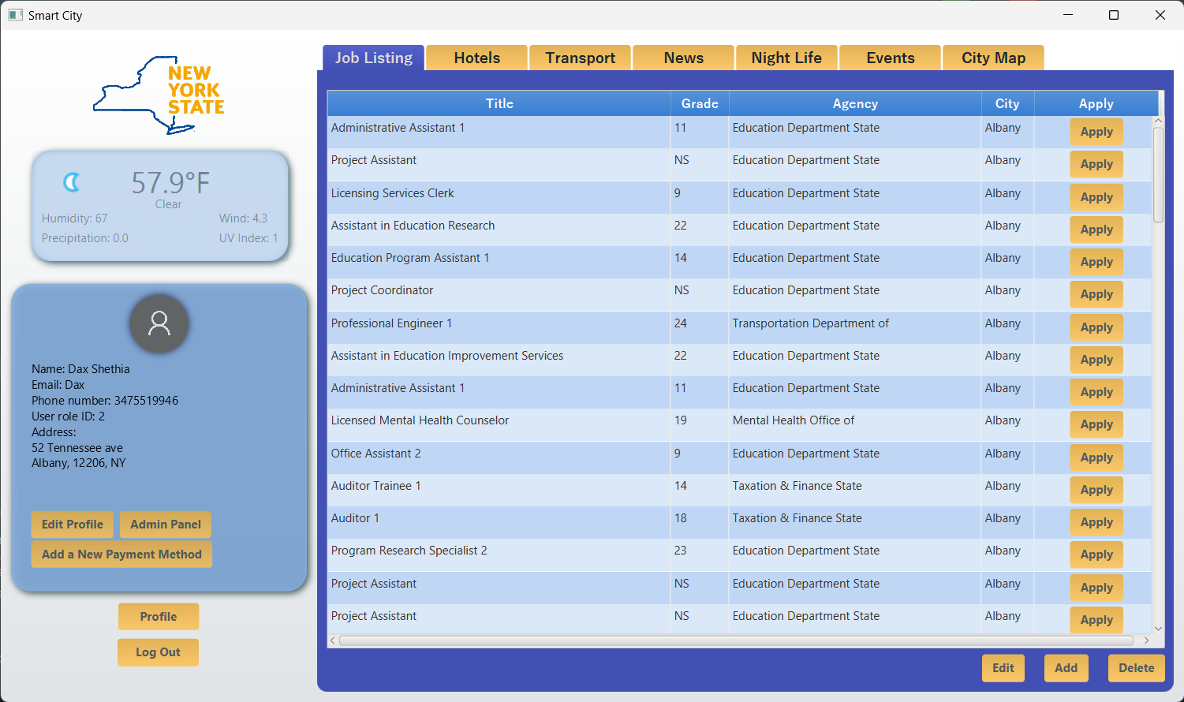
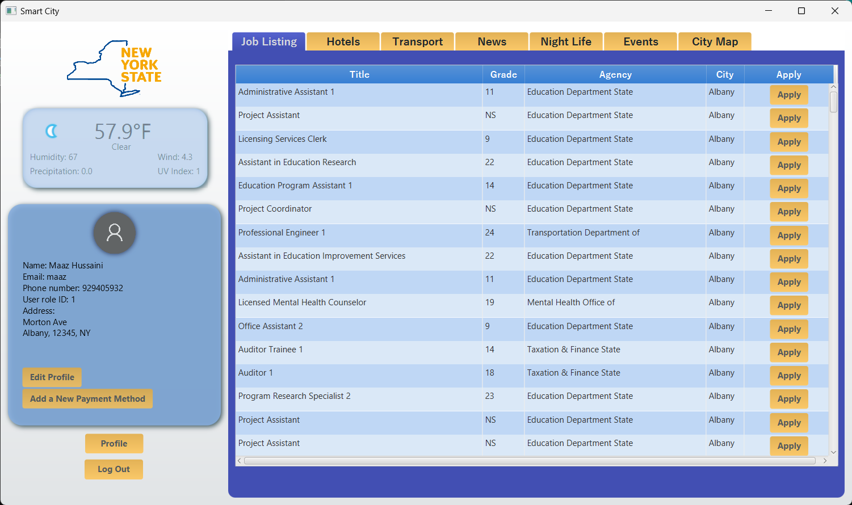
User Panel
The user panel displays the user's information, it also gives you an option to update your info if it changes.
The user panel includes a weather widget we created using WeatherAPI, it updates the weather based on conditions in the user's current location.
You can access your bank account from this panel.

Slide 21
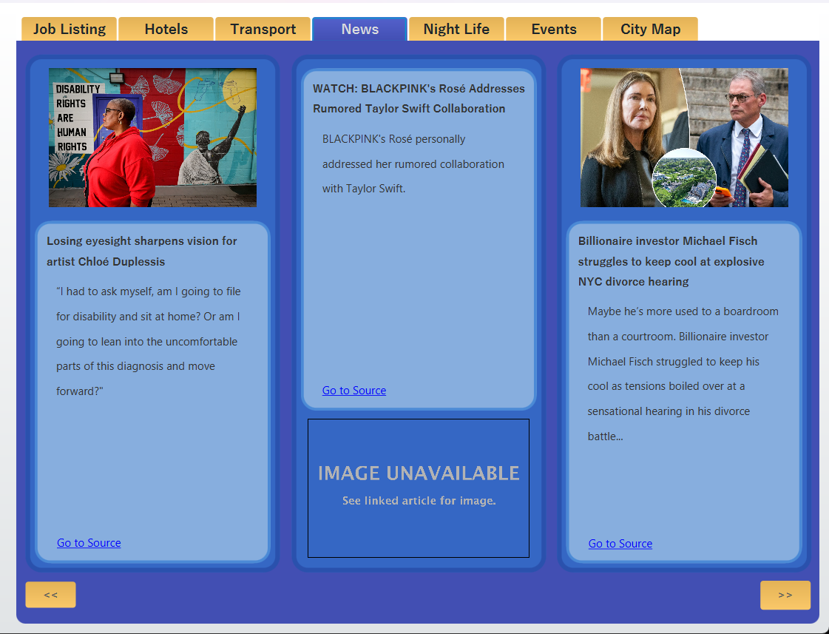
News
Users can view news stories we pull from NewData.io API. These stories are updated every hour.
The administrator doesn't have any function on this page because we want users to have access to all news stories available.

